Slide 1
ER Examples

Slide 2
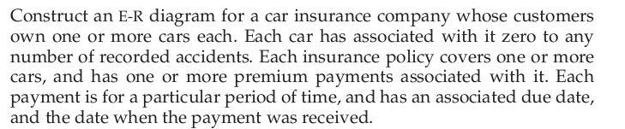

Slide 3
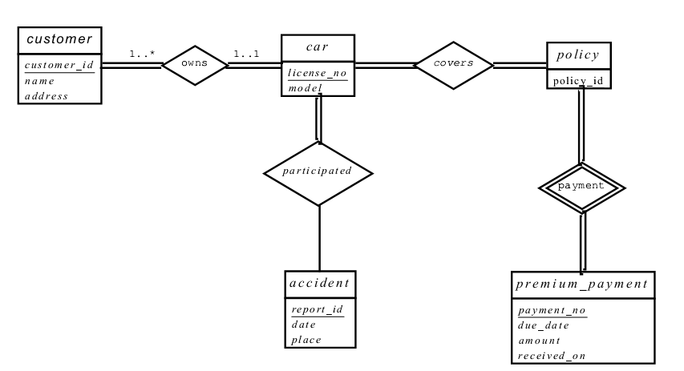

Slide 4
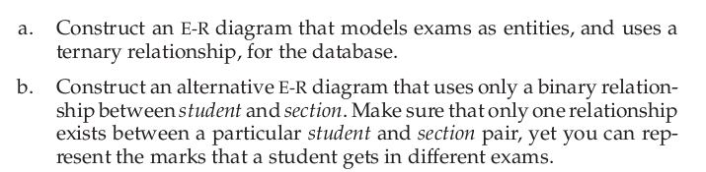

Slide 5
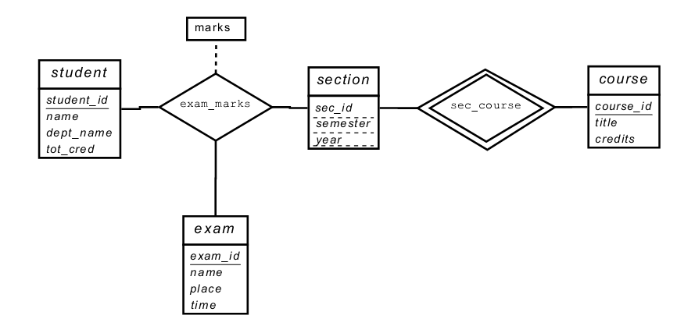

Slide 6
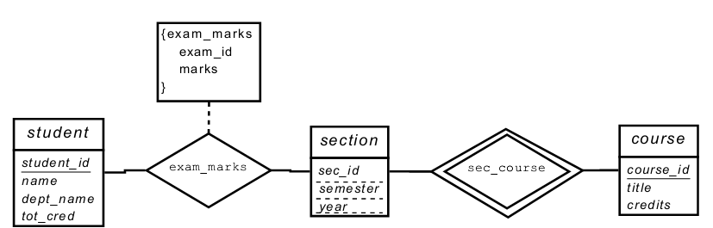
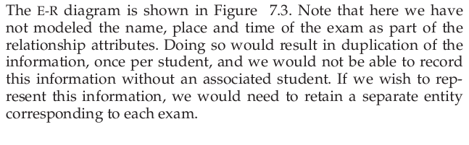

Slide 7
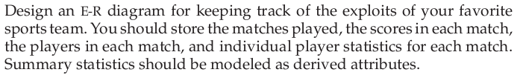
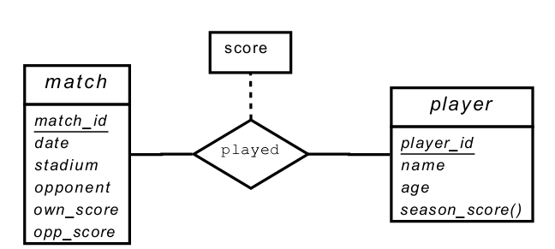

Slide 8

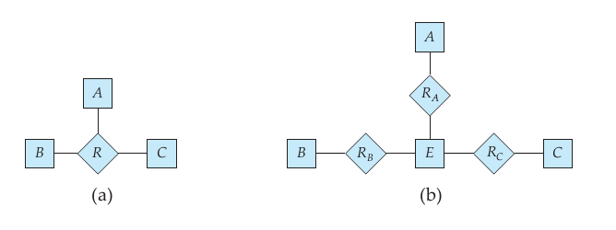
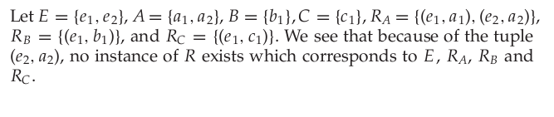

Slide 9

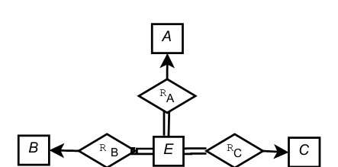


Slide 11

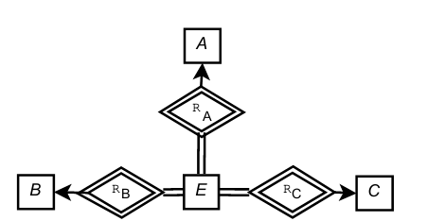

Slide 12
Galleries keep information about artists, their names (which are unique), birthplaces, age, and style of art.
For each piece of artwork, the artist, the year it was made, its unique title, its type of art (e.g., painting, lithograph, sculpture, photograph), and its price must be stored.
Pieces of artwork are also classified into groups of various kinds, for example, portraits, still lifes, works by Picasso, or works of the 19th century; a given piece may belong to more than one group.
Each group is identified by a name (like those just given) that describes the group.
Finally, galleries keep information about customers. For each customer, galleries keep that persons unique name, address, total amount of dollars spent in the gallery, and the artists and groups of art that the customer tends to like.

Slide 13
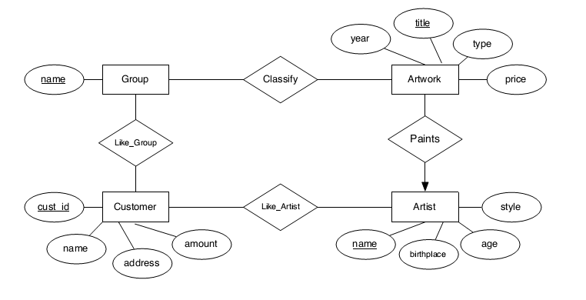

Slide 14

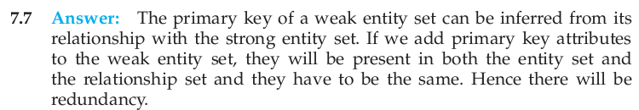

Slide 15

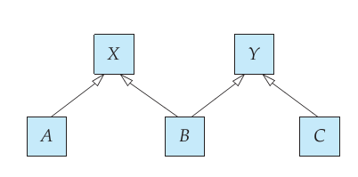
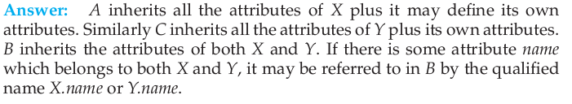

Slide 16
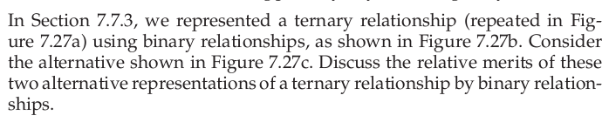
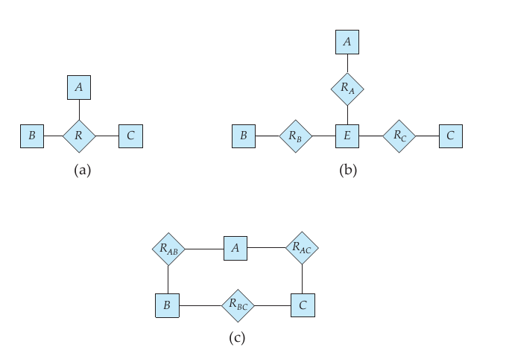

Slide 17
Entity vs. Relationship
First ER diagram OK if a manager gets a separate discretionary budget for each dept.
What if a manager gets a discretionary budget that covers all managed depts?
Redundancy: dbudget stored for each dept managed by manager.
Misleading: Suggests dbudget associated with department-mgr combination.
since
dbudget
name
dname
ssn
lot
did
budget
Employees
Manages2
Departments
name
ssn
lot
since
dname
Employees
did
budget
Manages2
Departments
ISA
This fixes the
problem!
Managers
dbudget
Notes:
6

Slide 18
Aggregation
name
ssn
lot
Employees
Used when we have to model a relationship involving (entity sets and) a relationship set.
Aggregation allows us to treat a relationship set as an entity set for purposes of participation in (other) relationships.
Employees are assigned to monitor SPONSORSHIPS.
Monitors
until
started_on
since
dname
pid
pbudget
did
budget
Projects
Sponsors
Departments
Aggregation vs. ternary relationship:
Monitors and Sponsors are distinct relationships, with descriptive attributes of their own.
Also, can say that each sponsorship
is monitored by at most one employee (which we cannot do with a ternary relationship).
Notes:
2

Slide 19
Entity vs. Attribute (Contd.)
from
to
name
dname
ssn
lot
did
budget
Works_In4 does not allow an employee to work in a department for two or more periods (a relationship is identified by participating entities).
Similar to the problem of wanting to record several addresses for an employee: We want to record several values of the descriptive attributes for each instance of this relationship. Accomplished by introducing new entity set, Duration.
Employees
Works_In4
Departments
name
dname
ssn
lot
did
budget
Employees
Works_In4
Departments
from
Duration
to
Notes:
5

Slide 20
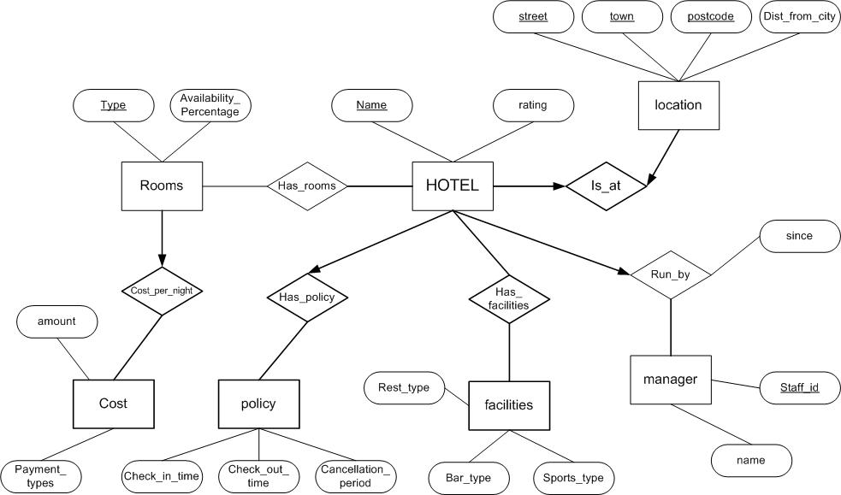
ERD (More Examples)
20
Notes:
20

Slide 21
ERD (More Examples)
Manages
Code
Name
Name
Employee
Is_a_Member
Department
Dept ID
Age
Salary
Participates
Start Date
has
Start Date
City
Name
Project
Branch
Budget
Address
Release Date
21
Notes:
21

